Slide 2


Slide 3


Slide 4

Ellos no te merecen…
¿Sainz será el nuevo campeón?

Slide 5
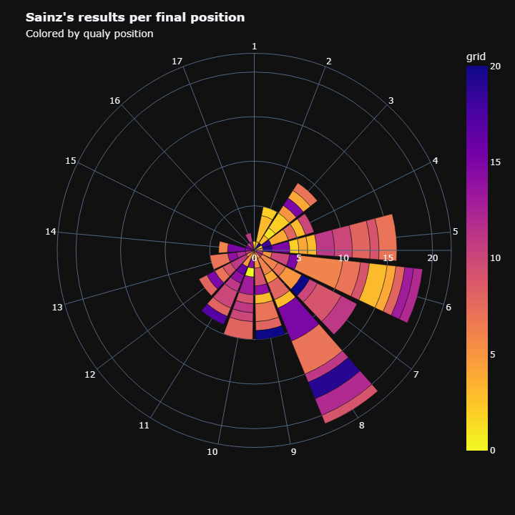

Slide 6
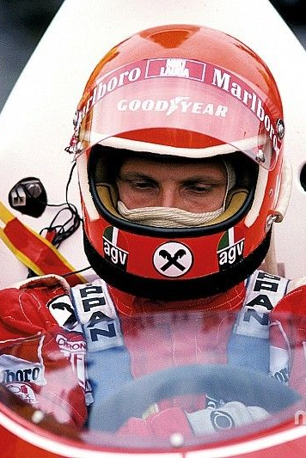
Dataset
Seasons
Constructor results
Constructor standings
Constructors
Drivers
Driver’s standings
Status
Races
Circuits
Qualifying
Lap times
Pit stops
Sprint results
Results
Seasons
Constructor results
Constructor standings
Constructors
Drivers
Driver’s standings
Status
Races
Circuits
Qualifying
Lap times
Pit stops
Sprint results
Results

Slide 7


Slide 8

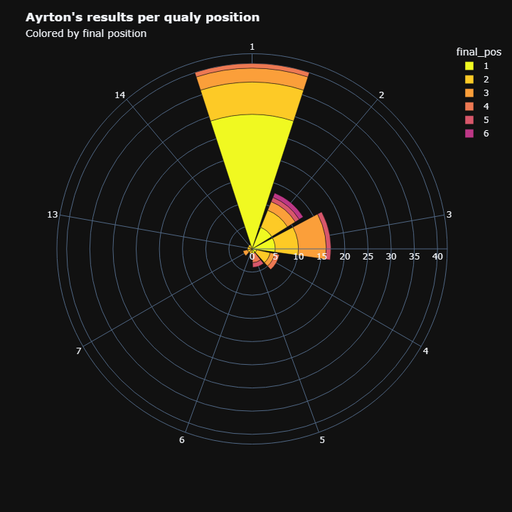
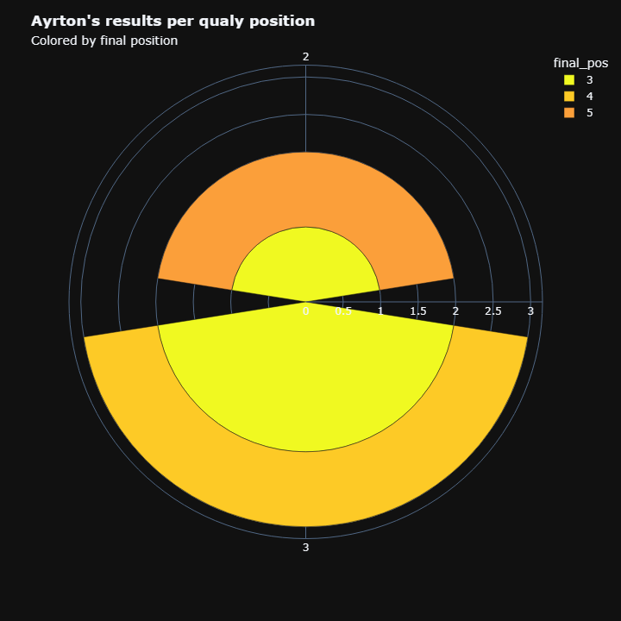
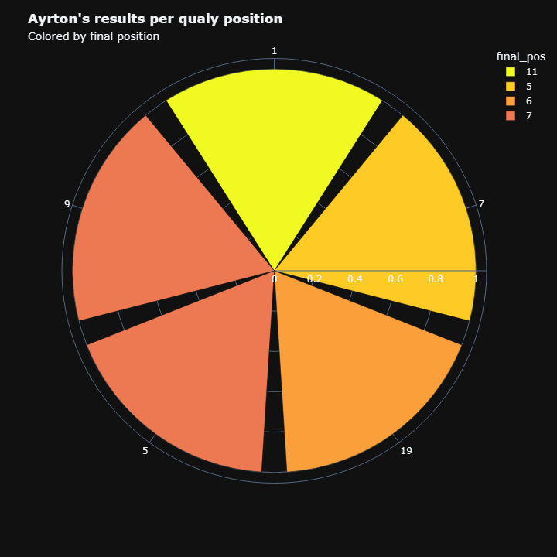

Slide 11
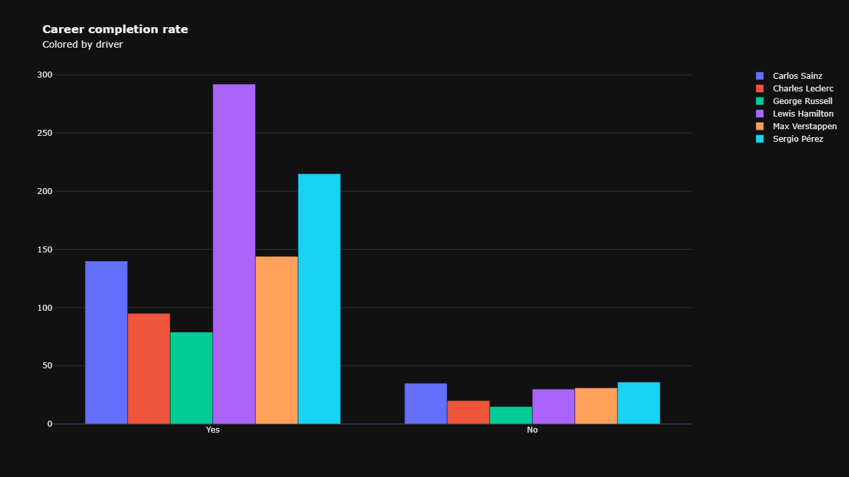

Slide 12
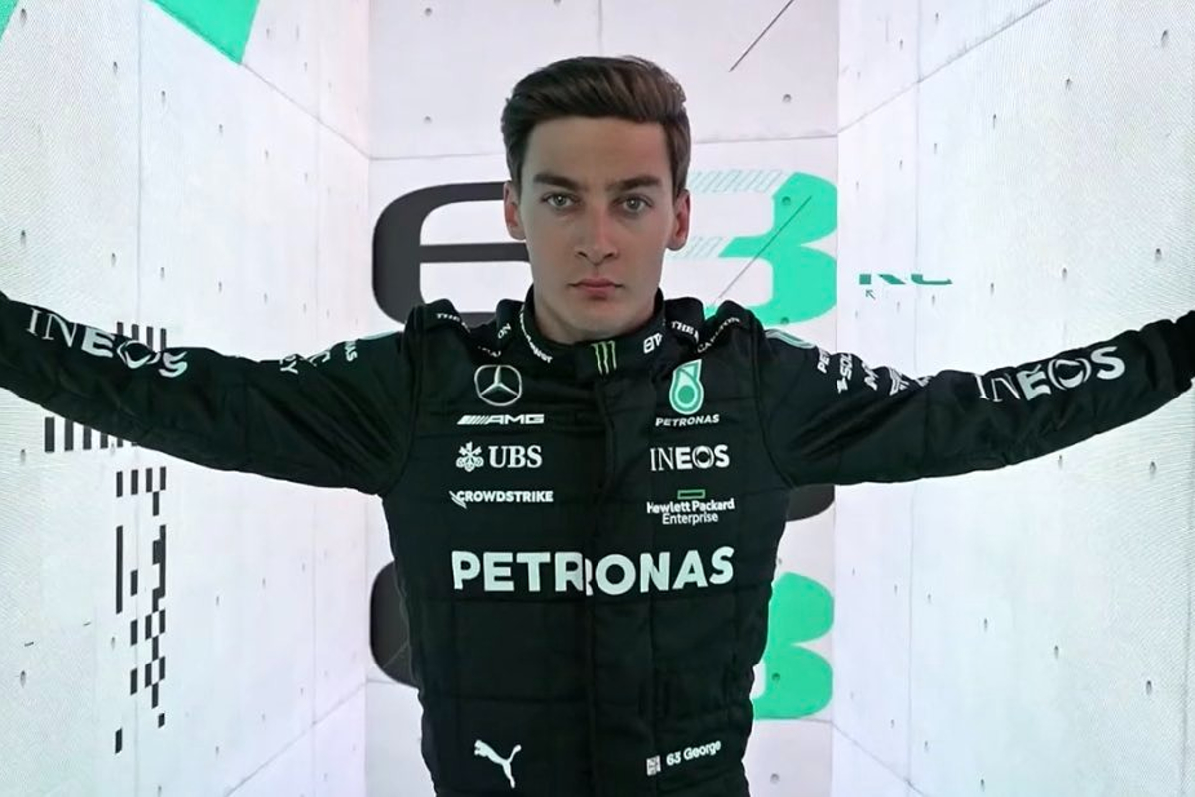

Slide 13
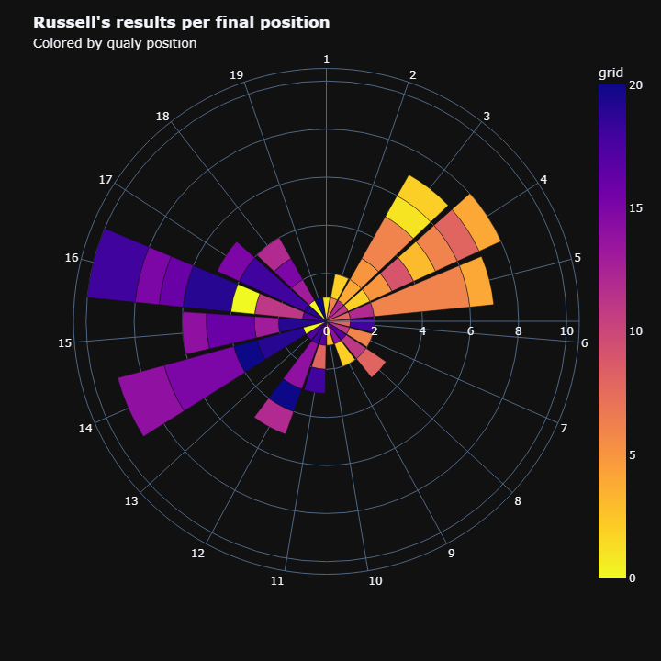

Slide 14


Slide 15
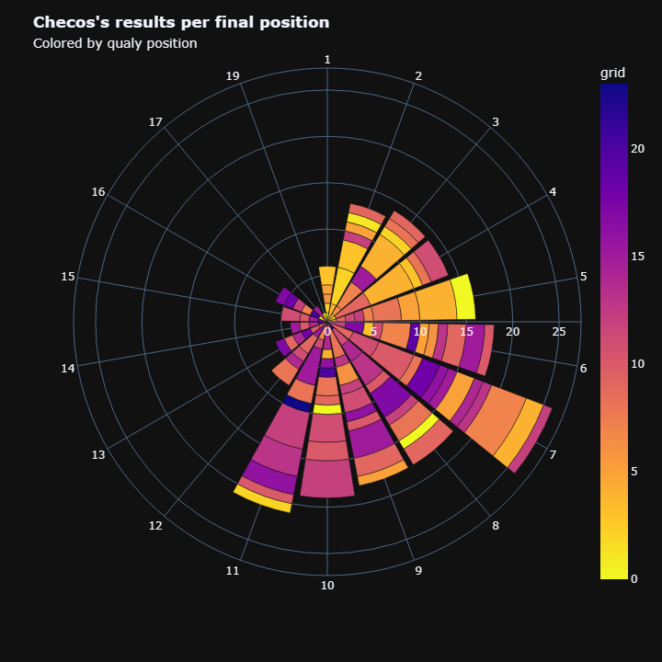


Slide 16
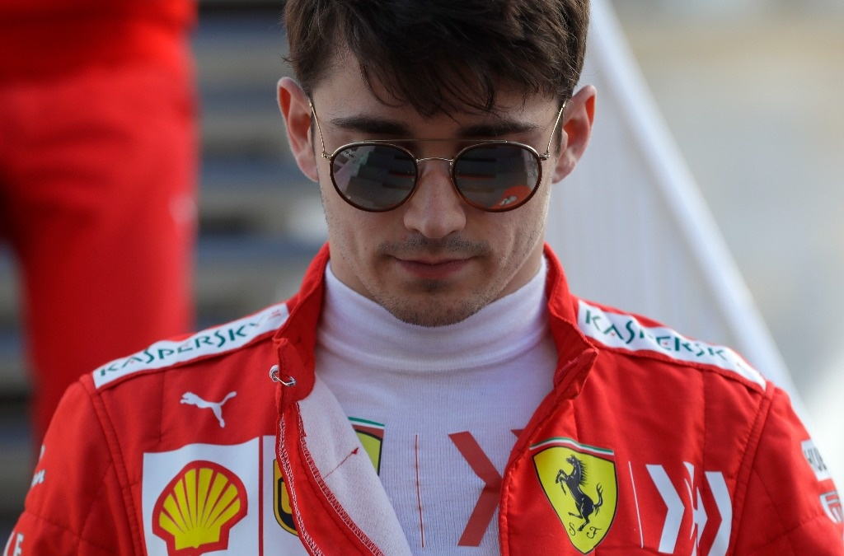

Slide 17
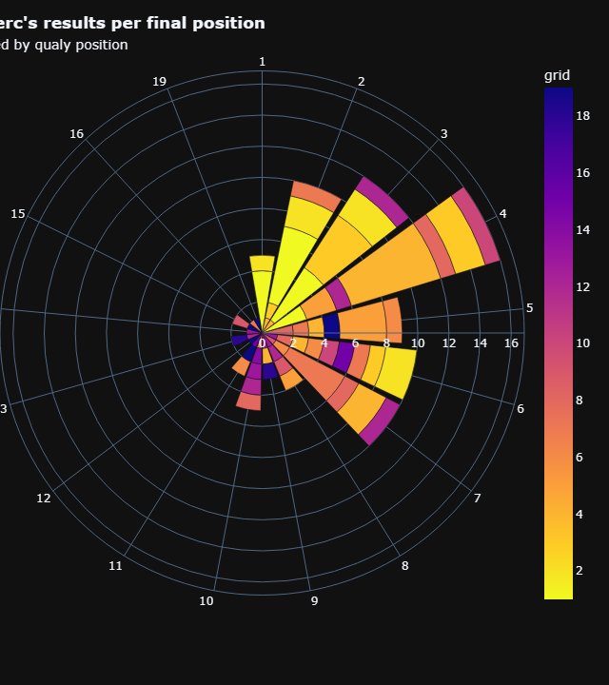

Slide 18


Slide 19
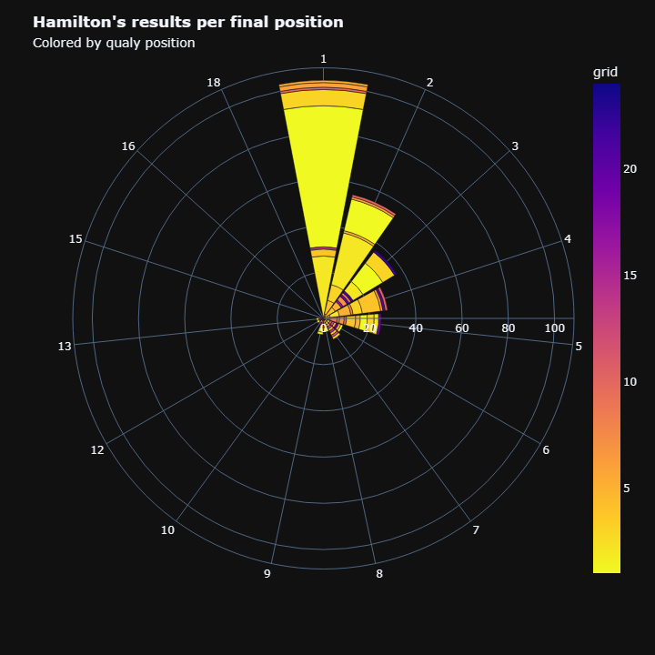

Slide 20


Slide 21
